Slide 1
Assembly Language and Assemblers
Adelaiye O.I

Slide 2
Assembly Language
Each personal computer has a microprocessor that manages the computer's arithmetical, logical, and control activities.
A processor understands only machine language instructions
Programming in 1’s and 0’s makes it difficult to:
Read
Edit and
Write
Hence the need for an alternative way of writing a set of instructions for the processor.

Slide 3
Assembly Language Cont’d
Low-level programming language.
Device specific
designed for a specific family of processors
Instructions are represented in symbolic code and a more understandable form.

Slide 4
Assembly Language
Having an understanding of assembly language makes one aware of −
How programs interface with OS, processor, and BIOS.
How data is represented in memory and other external devices.
How the processor accesses and executes instruction.
How instructions access and process data.
How a program accesses external devices.

Slide 5
Advantages of Assembly Language
It requires less memory and execution time.
It allows hardware-specific complex jobs in an easier way.
It is suitable for time-critical jobs.
It is most suitable for writing interrupt service routines and other memory resident programs.

Slide 6
The Processor
Nibble: 4 bits
Byte: 8 bits
Word: a 2-byte data item
Doubleword: a 4-byte (32 bit) data item
Quadword: an 8-byte (64 bit) data item
Paragraph: a 16-byte (128 bit) area
Kilobyte: 1024 bytes
Megabyte: 1,048,576 bytes

Slide 7
How the Computer Hardware Works
The hardware of a computer is made up of a number of components including processor, memory and registers
Registers are components of a processor.
It holds data and address.
The program is copied from an external drive to an internal memory for the program to be executed

Slide 8
Binary Number System
Contains only two digits 0 and 1.
Each binary position has a positional value
The position of the binary number to the value to the power of the base produces its positional value
The position states at 0 and increases by 1.
Binary 1 0 1 1 1 1 0 1
Position 7 6 5 4 3 2 1 0

Slide 9
Binary Number System
Position | 7 | 6 | 5 | 4 | 3 | 2 | 1 | 0
Bit Value | 1 | 1 | 1 | 1 | 1 | 1 | 1 | 1
Calculate value | 7² | 6² | 5² | 4² | 3² | 2² | 1² | 0²
Positional Value | 128 | 64 | 32 | 16 | 8 | 4 | 2 | 1
If all the bits are true the decimal representation will be:
128+64+32+16+8+4+2+1= 255
Can be calculated using 2^{n}-1 = 2⁸ – 1 =255

Slide 10
Hexadecimal Number System
Has a base of 16
It contains 16 digits
It’s a combination of alphabets and Numbers
0 to 9 and letters A to F
It is used in abbreviating long binary codes in computers.
Each hexadecimal number represents 4 binary digits (¹/₂ a byte)

Slide 11
Relationship between Binary, Decimal and Hexadecimal
Decimal | Binary | Hexadecimal
0 | 0000 | 0
1 | 0001 | 1
2 | 0010 | 2
3 | 0011 | 3
4 | 0100 | 4
5 | 0101 | 5
6 | 0110 | 6
7 | 0111 | 7

Slide 12
Relationship between Binary, Decimal and Hexadecimal 2
Decimal | Binary | Hexadecimal
8 | 1000 | 8
9 | 1001 | 9
10 | 1010 | A
11 | 1011 | B
12 | 1100 | C
13 | 1101 | D
14 | 1110 | E
15 | 1111 | F

Slide 13
Conversion
Conert the following to Binary and Decimal
CCDD
12AD
FFE5
Convert the following to Hexadecimal
10111110
11110000
10101010

Slide 14
Assembly language syntax
To add the EAX and EBX registers and store the result back into EAX is encoded by the following
03 C3 (Hex code)
add eax, ebx (assembly language)
Add is the mnemonic
eax, and ebx are the operands

Slide 15
Operands
Register: These operands refer directly to the contents of the CPU’s registers.
Memory: These refer to data in memory. The address of the data may be a constant hardcoded into the instruction or may be computed using values of registers. Address are always offsets from the beginning of a segment.
Immediate: These are fixed values that are listed in the instruction itself. They are stored in the instruction itself (in the code segment), not in the data segment.
Implied: These operands are not explicitly shown. For example, the increment instruction adds one to a register or memory. The one is implied.

Slide 16
Basic Instructions
MOV
mov eax, 3 ; store 3 into EAX register (3 is immediate operand)
mov bx, ax ; store the value of AX into the BX register
ADD
add eax, 4 ; eax = eax + 4
add al, ah ; al = al + ah

Slide 17
Basic Instructions
SUB
sub bx, 10 ; bx = bx – 10
sub ebx, edi ; ebx = ebx – edi
INC and DEC
inc ecx ; ecx++
dec dl ; dl--

Slide 18
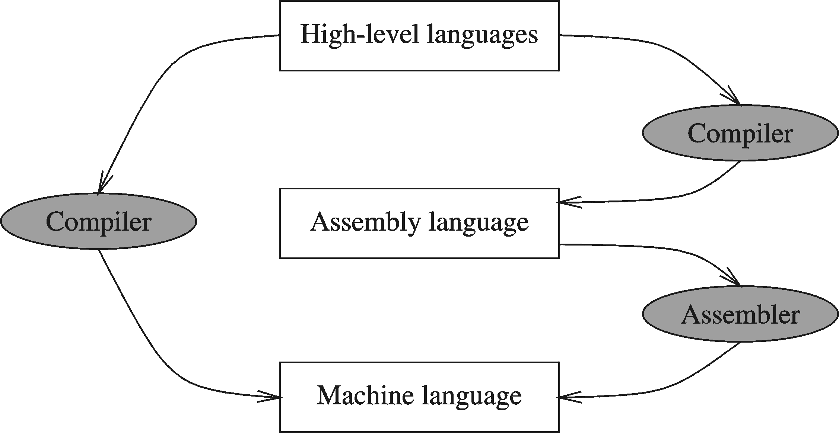
Relationship between HLL and Assembly Language

Slide 19
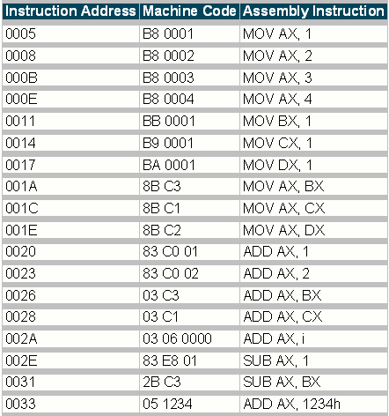
Machine code vs Assembly code

Slide 20
Relationship between HLL and Assembly Language
English: D is assigned the sum of A times B plus 10.
High-Level Language: D = A * B + 10
A statement in a high-level language is translated typically into several machine-level instructions
Intel Assembly Language:
mov eax, A
mul B
add eax, 10
mov D, eax
Intel Machine Language:
A1 00404000
F7 25 00404004
83 C0 0A
A3 00404008

Slide 21
Assembler
Assembly language is writing a set of instructions into files.
These set of instructions need to be converted to be for the machine to execute.
Assembler is the tool used to convert the instructions written in Assembly language to Machine code
Software
First software layer above hardware

Slide 22
Assemblers
Read instructions sequentially
Some examples of good assemblers are
The GNU Assembler (GAS)
Microsoft Assembler (MASM)
Borland Turbo Assembler (TASM)

